Slide 1
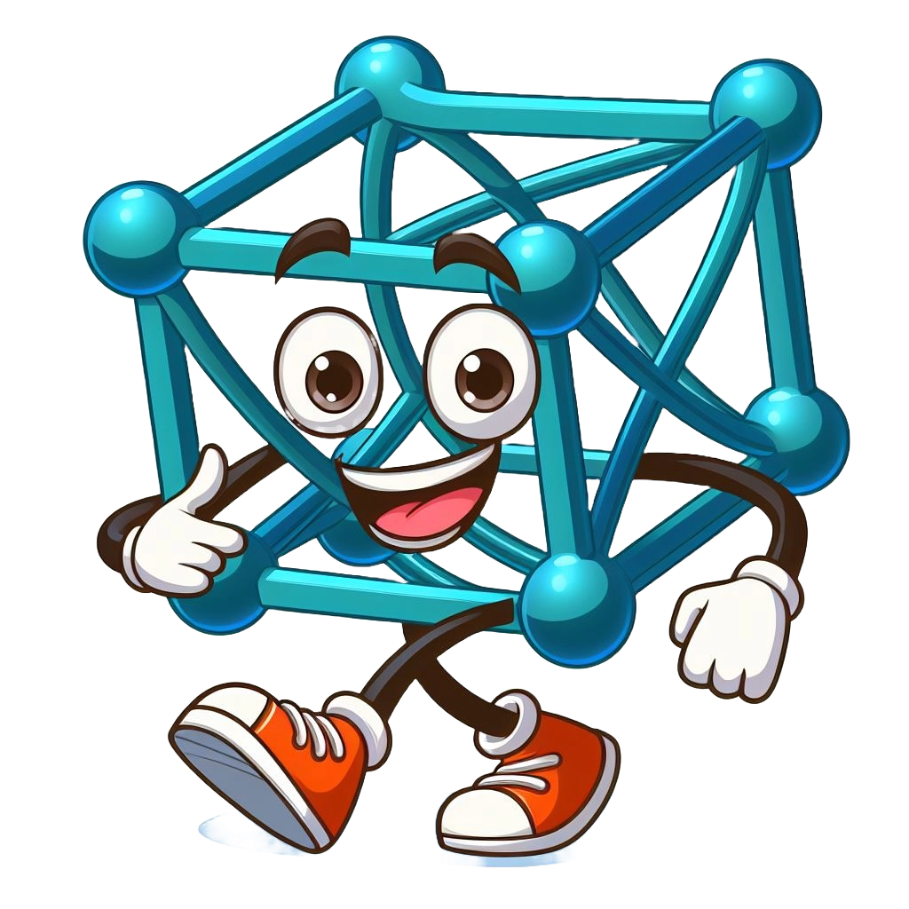
The Magical World of Tensors!
Discover how Tensors help computers learn and see the world with me, Timmy the Tensor!

Slide 2

What are Tensors?
Tensors are like magical boxes that hold numbers and data for deep learning.
Imagine them as treasure chests filled with valuable information!

Slide 3
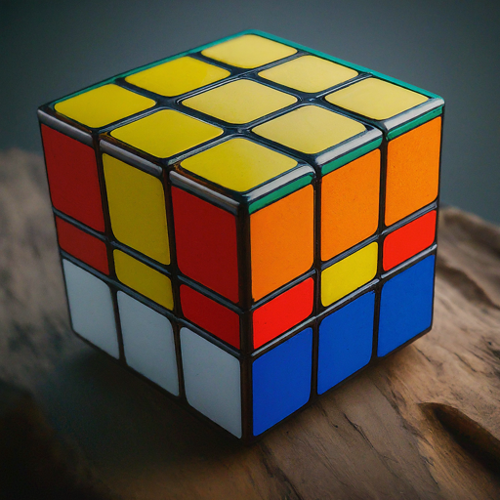
Tensors in the Real World
Tensors are everywhere! They help us understand and represent things like images, sounds, and text.
Just like a Rubik's Cube has different colored squares, tensors have different values arranged in a grid

Slide 4
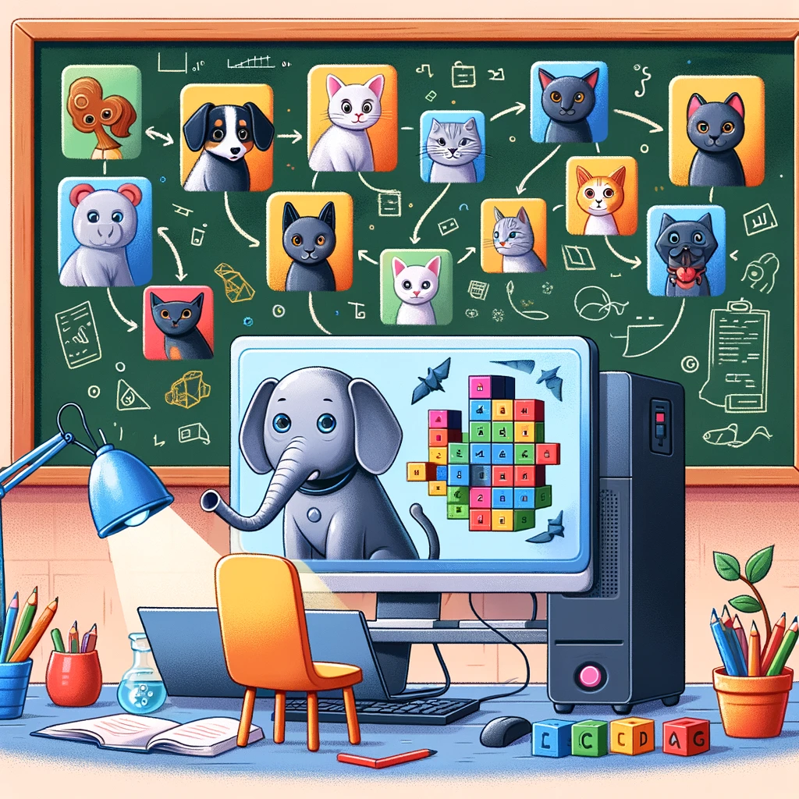
Tensors in Action
Let's see how tensors work in deep learning!
Imagine we're teaching a computer to recognize different animals.
We use tensors to show the computer pictures of cats, dogs, and elephants.

Slide 5

Layers of Learning
Deep learning is like building a tower. Each layer of the tower learns something new about the data.
Tensors pass through these layers, and each layer adds more understanding, like adding floors to our tower!

Slide 6

Training Tensors
Training tensors is like training for a sport or learning an instrument. The numbers inside the tensors are changed little-by-little until the computer gets really good at recognizing animals.
It's like a hero training to save people!

Slide 7
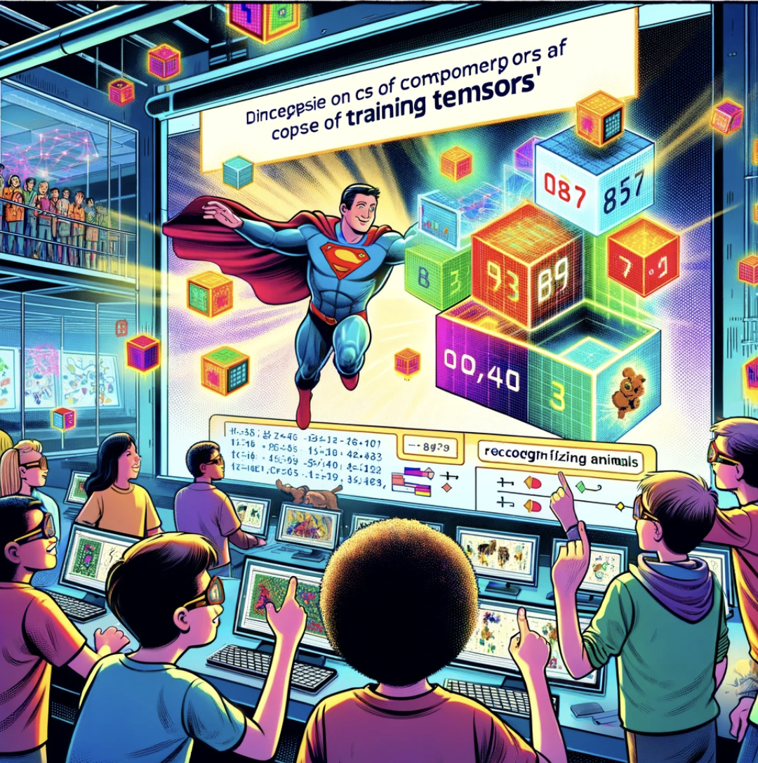
Using Tensors for Superpowers
Once our computer superhero is trained, it can do amazing things like detecting diseases from X-rays or even predicting the weather!
Tensors give our computer superhero its superpowers!

Slide 8

Conclusion
Tensors are incredible tools that help us unlock the secrets of deep learning.
With tensors, we can teach computers to do all sorts of magical things and make the world a better place!

Slide 9
Thank You!
Thank you for joining me on this Fantastic Journey of Tensors!
Remember, you can be a deep learning explorer too, and tensors will be your trusty companions on your adventures!

Slide 10
References:
Goodfellow, I., Bengio, Y., & Courville, A. (2016). Deep Learning. MIT Press.
Kan, Enoch (2018). “Quick ML Concepts: Tensors.” https://towardsdatascience.com/quick-ml-concepts-tensors-eb1330d7760f.
Nielsen, M. A. (2015). Neural Networks and Deep Learning. Determination Press.
Zaki, Mohamed (2023). “A Simple Introduction to Tensors: Understanding The Basics.” https://medium.com/@zakimedbio/a-simple-introduction-to-tensors-understanding-the-basics-b35aa110972e.
Images and characters created with Bing Image Creator

